Slide 1
Motion controlled game system using computer vision
Vidyavardhini’s College of Engineering & Technology
K.T. Marg, Vartak College Campus, Vasai Rd, Vasai-Virar, Maharashtra 401202
Department of Artificial Intelligence and Data Science
Group No: 08
Parth Puri 24
Divyah Mandavia 11
Devashree Pawar 22
Project Guide
Prof. Priyanka Bhoir
Date: 29/04/2022

Slide 2
Contents
Introduction
Problem Statement
Literature Survey
Proposed System
Architecture
Details of Hardware/Software used
Experiment and Result Analysis
Conclusion
References
Thank you

Slide 3
Introduction
This project presents a design of a game controller interface based on visual processing.
Computer vision based interface to a game holds a promise of rich natural interaction and thus provides a realistic gaming experience.
In our system hand detection is totally based on computer vision and we do use markers.

Slide 4
Problem Statement
To develop a system that recognizes motion gestures so as to perform various commands/operations in a game.

Slide 5
Literature Survey
Sr. No. | Paper Title | Advantages | Disadvantages
1 | Hand Gesture Tracking and Recognition based Human-Computer Interaction System and Its Applications | The most significant advantage of this paper is that its gesture-based HCI system is its natural interaction. | This system works a little bit slow.
2 | Hand Mobility Recovery Through Game Controlled by Gestures | The primary purpose of the application is to incite the user to perform as many hand exercises as possible. | The main drawback consists in the fact that the system needed a 6-camera module and hand- held sensors to detect movement.
3 | Human Computer Interaction: Game Developed in Python using Gesture Recognition | This paper gives light on conceivable outcomes of utilizing computer vision to take care of genuine issues are many. | The disadvantage of this paper system requirement.
4 | Vision Based Game Controller Interface | The main advantage of this paper is that it helps fast pace gamers to gain more control over the game as compared to traditional method. | This system can get more complex by adding additional gestures.
Sr. No
Paper Title
Advantages
Disadvanta

Slide 6
Proposed system
To solve the current problem statement we have divided the visual screen into five unique parts. We have then allocated movements to each of them and have also added symbols to differentiate between different tasks.

Slide 7
Architecture
Live video capture using camera
Implementing landmark points on hand
Setting up key binding using python library
Importing libraries OpenCV, Numpy, Tensorflow
Integrating the key bindings with the code
Integrating the code with OpenCV
Setting up data set for the game
Setting up the code as a application
Testing of the game

Slide 8
Details of Hardware/Software used
PyCharm IDE with Python 3.8
Minimum requirements – Windows 7/10/11,Processor – intel core i5, intel core i7.

Slide 9
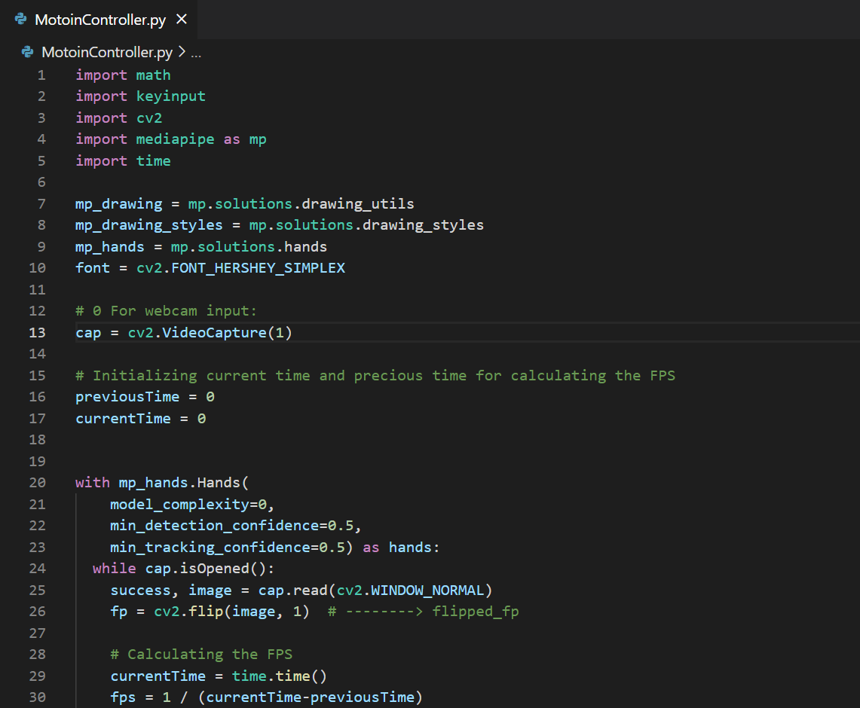
Experiment and Result Analysis

Slide 10
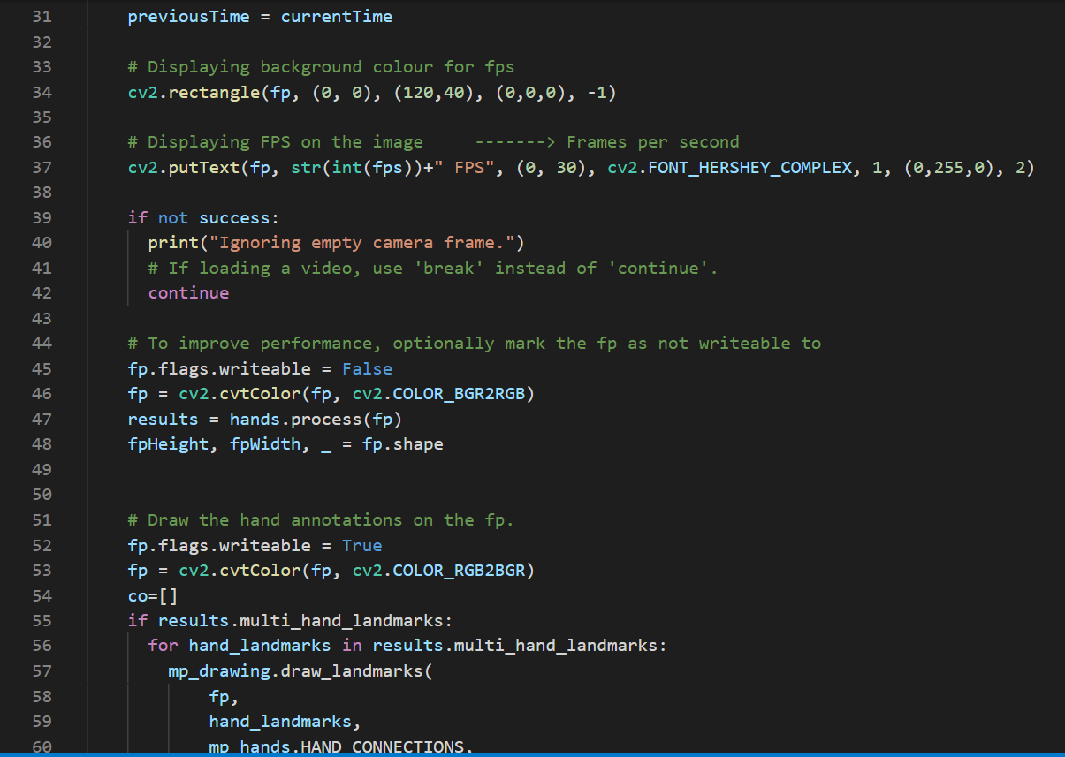

Slide 11
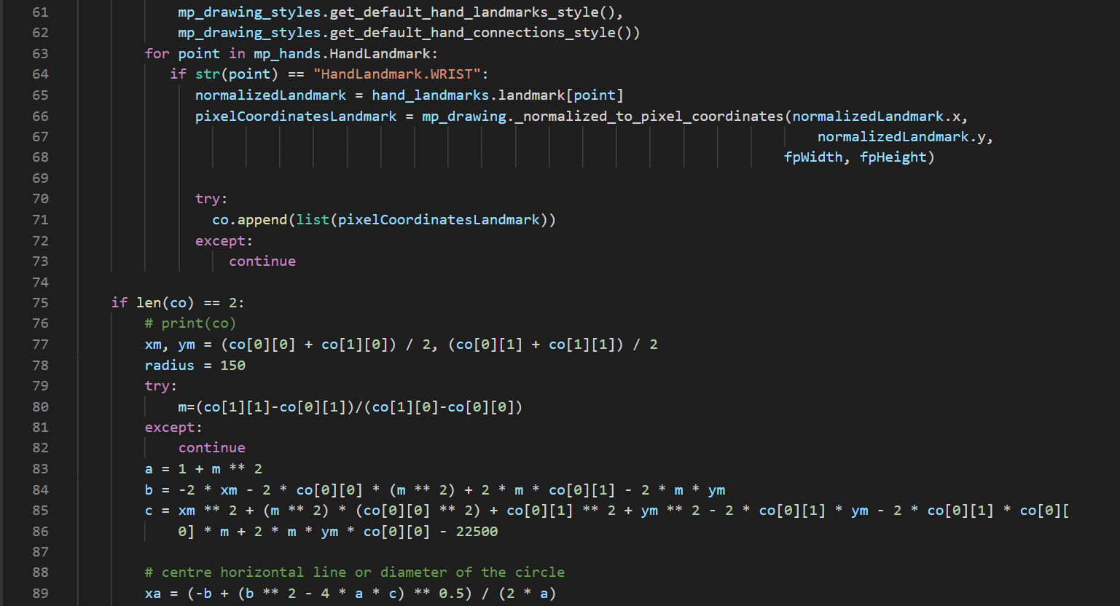

Slide 12
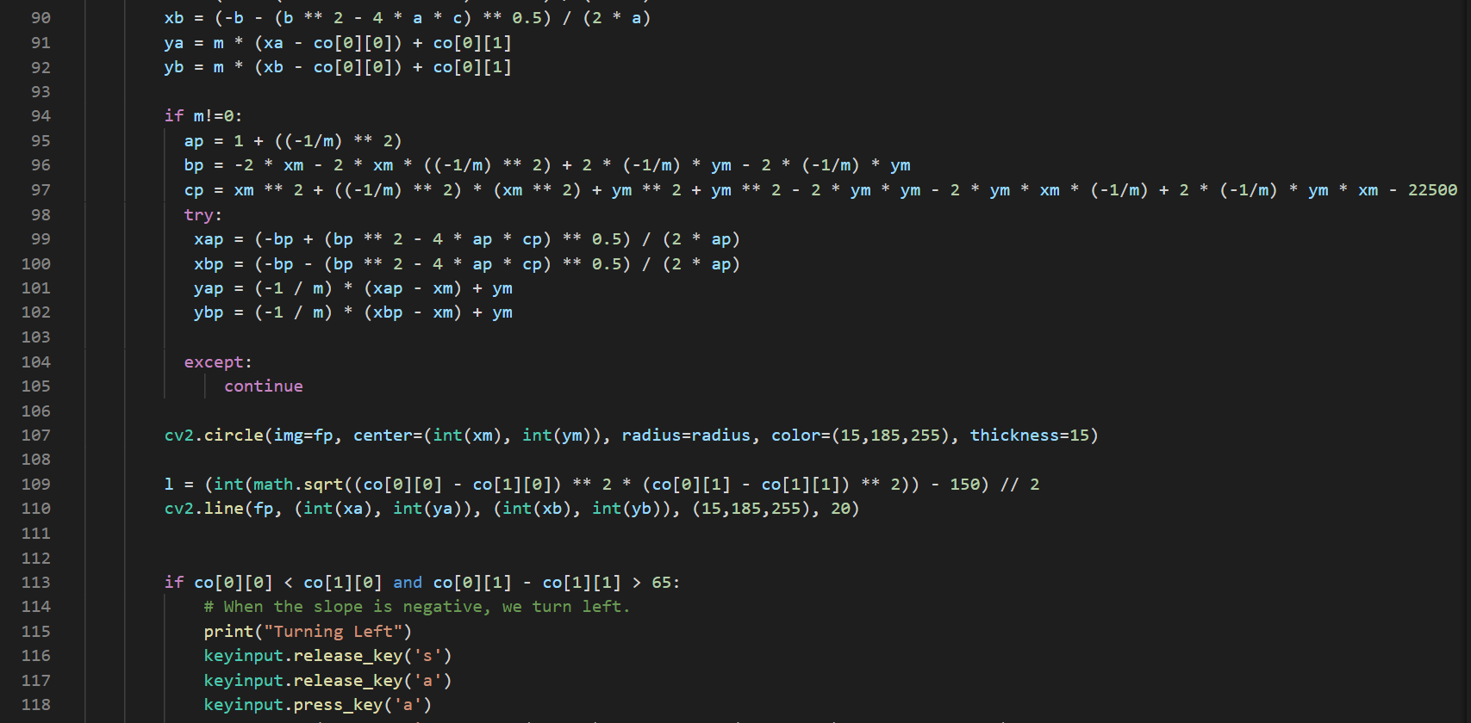

Slide 13
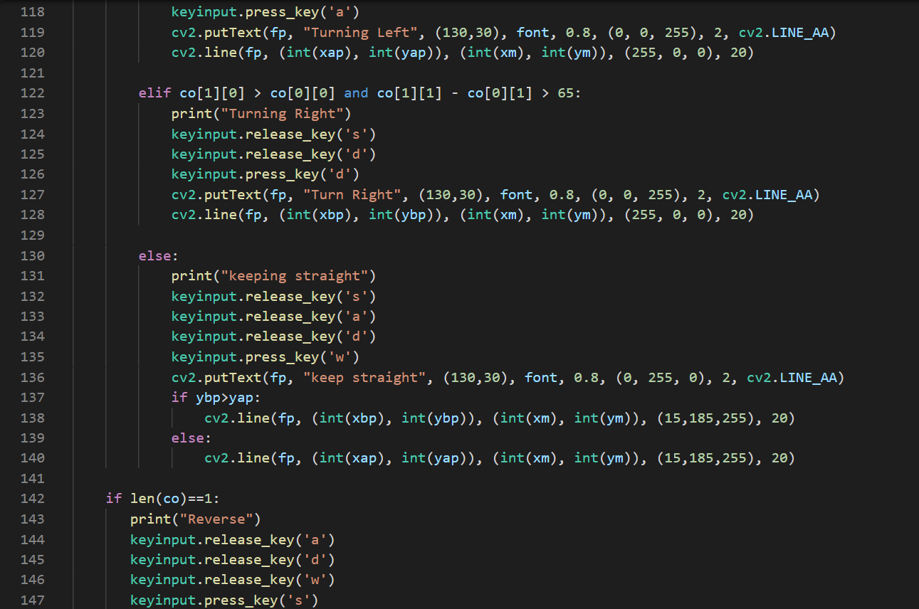

Slide 14
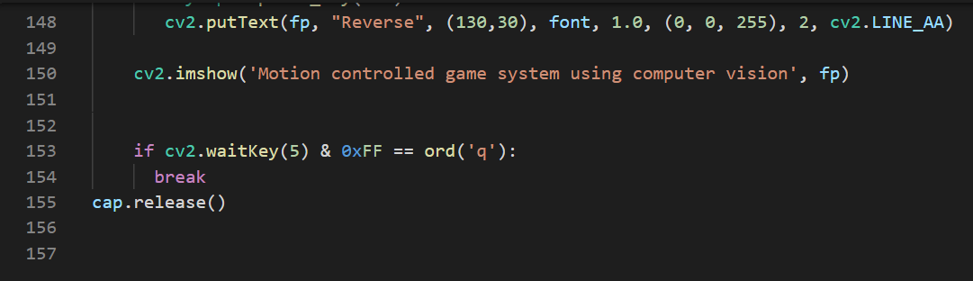

Slide 15
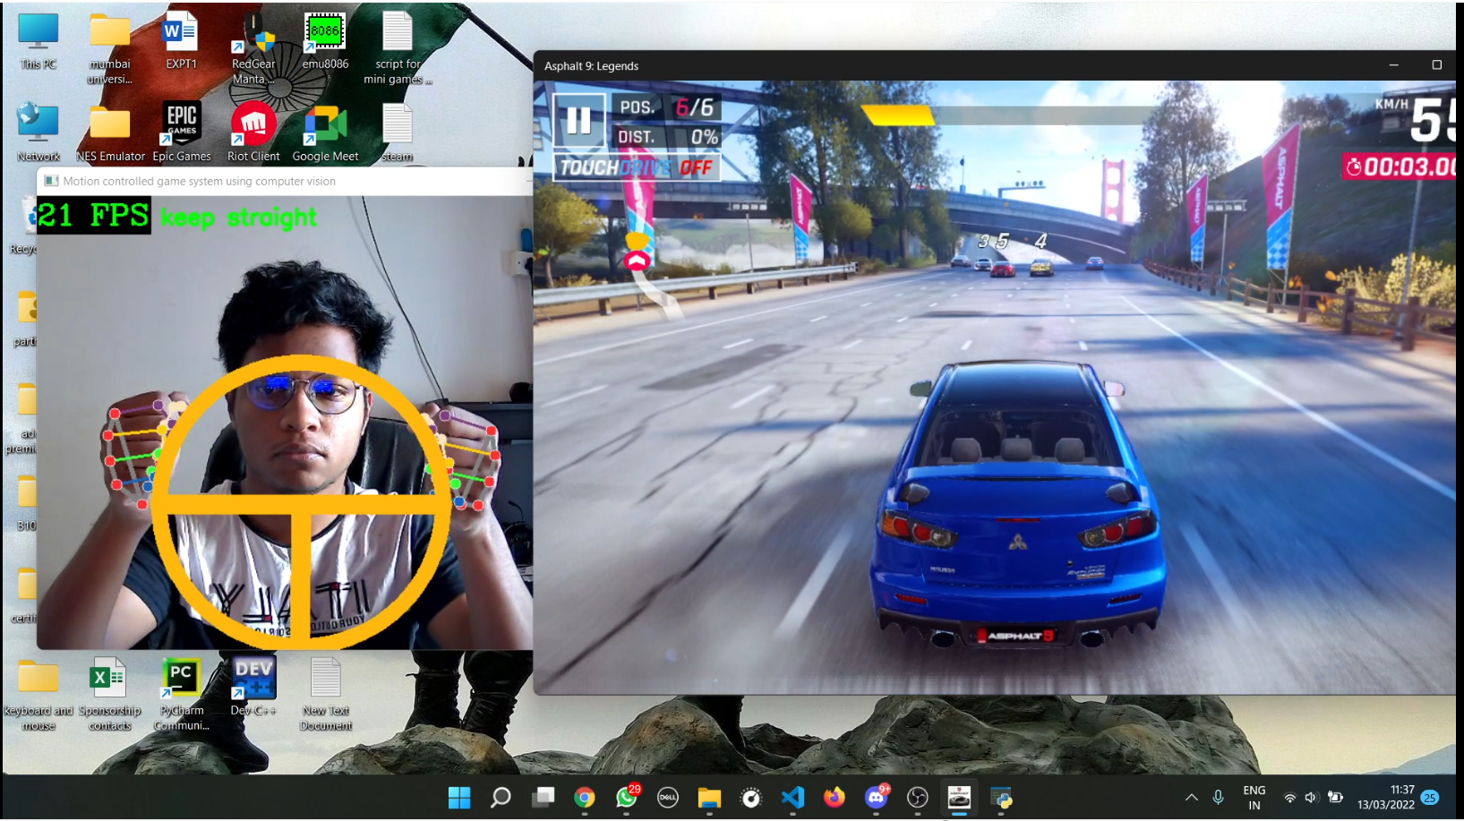
Result

Slide 16
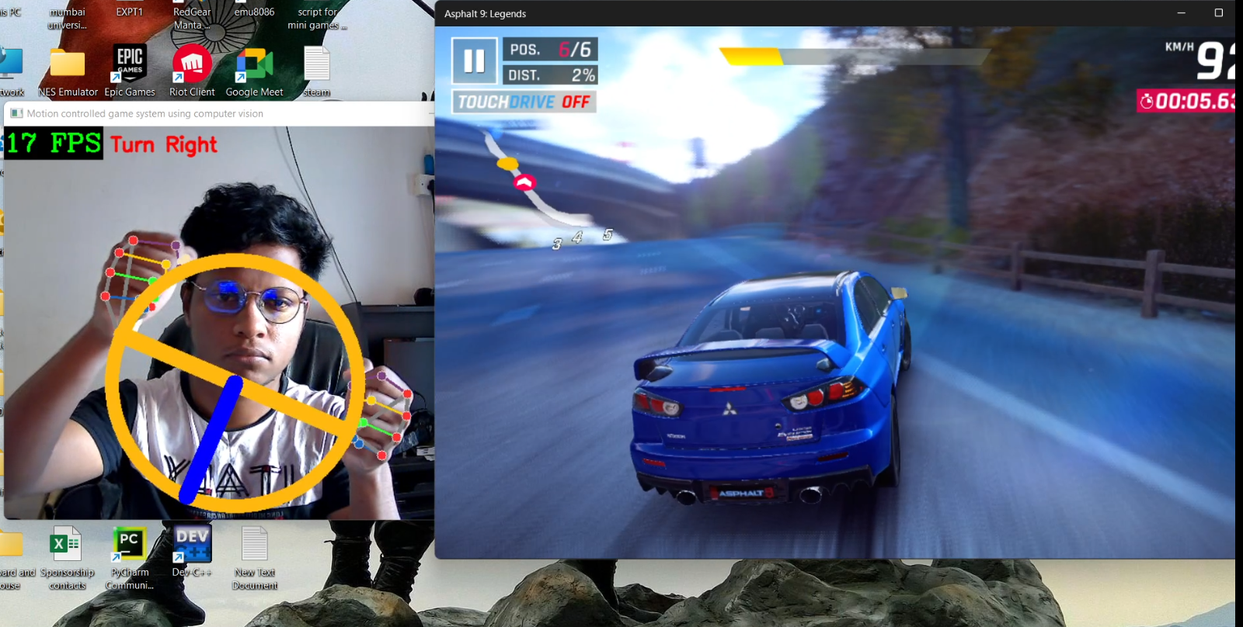

Slide 17
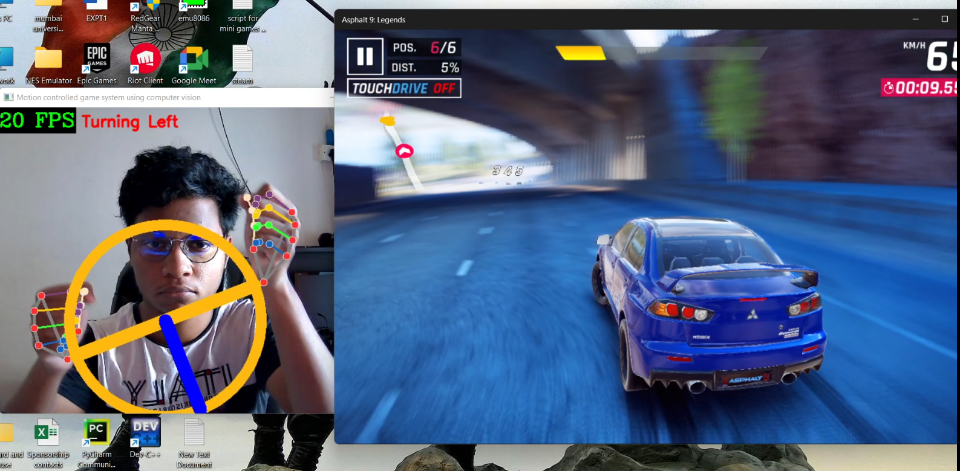

Slide 18
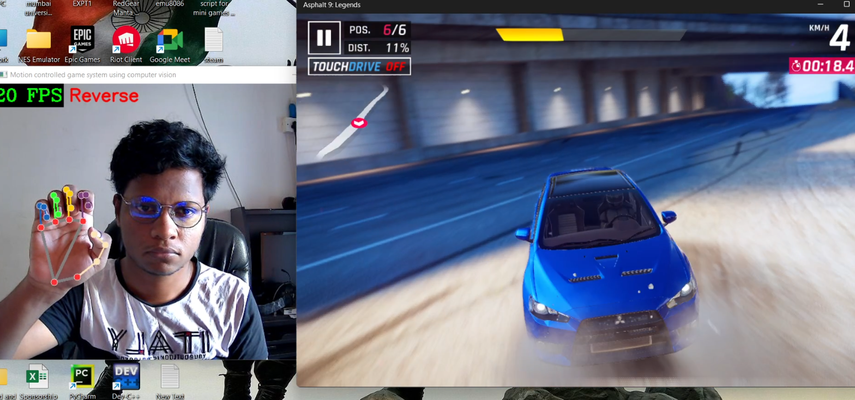

Slide 19
Conclusion
With the help of OpenCV it has become very easy to implement hand gestures which has made this task faster and simpler.

Slide 20
References
[1] Y. Wen, K. Zhang, Z. Li, and Y. Qiao, “A Discriminative Feature
Learning Approach for Deep Face Recognition,” Proc. of European
Conference on Computer Vision (ECCV), pp. 499-515, 2016.
[2] Y. Li, “Hand gesture recognition using Kinect,” Proc. of IEEE Control
and Decision Conference (ICDC), pp. 196-199, 2017.
[3] J. Wu and J. Cheng, “Bayesian Co-Boosting for Multi-modal Gesture
Recognition,” Journal of Machine Learning Research, vol. 15, no. 1, pp.
3013-3036, 2017.
[4] Q. Pu, S. Gupta, S. Gollakota, and S. Patel, “Whole-home gesture
recognition using wireless signals,” Proc. of International Conference on
Mobile Computing & NETWORKING ACM, pp.27-38, 2013.
[5] C. H. Morimoto and M. R. M. Mimica, “Eye gaze tracking techniques for
interactive applications ☆,” Computer Vision & Image Understanding,
vol. 98, no. 1, pp. 4-24, 2005.

Slide 21
Thank you

